Slide 1
Lec 11: Managing Communication and Projects, and Financing the Journey
EEE 452: Engineering Economics and Management
M. Rokonuzzaman, PhD
Zaman.rokon.bd@gmail.com
www.the-waves.org
©️Rokonuzzaman
--use is permitted only for the purpose of EEE 452 (sections 1,2, 3, 4 & 5offered at NSU in Spring 2023;no consumption and distribution is allowed for any other purpose

Slide 2
Communicate
Studies have been done on why projects fail. The Project Management Institute (PMI) reported in the Pulse of the Profession® (2013a) that poor communication is the number one reason why projects fail. In fact, PMI states that poor communications is a contributing factor in 56% of the projects that failed.
As an engineer, you will be leading your work, whether as team leader or team member. Your job is to create something new—adding and advancing product or process features, advancing technology, killing a product, inventing technology or innovating new products, changing technology core, or establishing a technology facility.
No body did it before. No body knows its importance. No body exactly know how to get it done.
You have four important jobs—i. communicate ideas to your team members, senior managers, and other stakeholders, ii. keep communicating through out the process of refining and approving ideas, iii. communicate to yourself and team members how to be done, and iv. communicate what is being done.
Hence, communication will be at the core your profession to develop new things. Communication will take place in oral, written, and demonstration forms. It will take place in both formal and information settings. You will face also competition in communicating. Communication takes time and other resources—but produces no tangible output. Communication also runs the risk of causing errors—production of wrong output. Hence, the challenge is how to effectively and efficiently communicate.
Motivation:
Technical Leadership
“Guiding head of a technical group”
Two essential tools
Communicate to customer and to your team
Organize, plan and manage the technical project

Slide 3
COMMUNICATE INTENSIVELY, DIFFERENTLY
Set your goal—what to achieve should be spelled out at the outset.
Shout out loud—you're doing something unusual here by asking for new ideas or responding to someone’s ideas. Create your own internal branding and tone of voice that should deliberately differentiate you from your standard corporate communications.
Give and receive feedback and review— It's critical that you appreciate feedback of others and ask them to elaborate where necessary, and then provide feedback on that again. if you do it right, it's just amazing to see your crowd collaborate and turn those initial hunches into fully fledged solutions!
Promote collaboration—It's not just about submitting ideas but also about commenting on others' ideas or providing feedback on proposed plans. Involve more and more people into the discussion. Promote collaboration instead of competition.
Share progress--Build, measure, learn sounds super simple and straightforward. It demands keep communicating about your progress, success and failures.
Take your crowd to the next level--Over time, you can consider aligning your stakeholders more in-depth on theories like Design Thinking.
Build transparent process and reporting structure— Focus on key performance indicators (KPIs) to build trust, grow sustainable sponsorship, and engage your audience.
Articulate and Document with clarity.

Slide 4
Do Your Homework
Think Before You Present
Who are your audience, why are they listening?
What is one or two messages you want to leave with your audience?
What is the message for each slide
Who & where
Technology and research group of interest
Specific Professor or research staff
What
Specific thesis project idea – some details
Why
Personal interest, Future opportunities, Financial support
When
Progress and plan – this term and beyond
Communication is organized around projects—for getting approved, financed, planned, executed, and delivered.

Slide 5
Projects
Your career will be organized as a collection of projects—for making a series of unique deliveries.
A project is “a temporary endeavor undertaken to accomplish a unique product or service”
Attributes of projects
unique purpose
temporary
require resources, often from various areas
should have a primary sponsor and/or customer
involve uncertainty
Diverse career opportunities
Leadership role
Most future activities are team and/or multi-organization oriented
How to help teams to work together
Startup business plans
At time of Global GDP $40 trillion:
The U.S. spends $2.3 trillion on projects every year, an amount equal to one-quarter of the nation’s gross domestic product (GDP).
The world as a whole spends nearly $10 trillion of its $40.7 trillion gross product on projects of all kinds.
More than sixteen million people regard project management as their profession; on average, a project manager earns more than functional specialists.

Slide 6
Advantages of Using Formal Project Management
Better control of financial, physical, and human resources
Improved customer relations
Shorter development times
Lower costs
Higher quality and increased reliability
Higher profit margins
Improved productivity
Better internal coordination
Higher worker morale

Slide 7
The Triple Constraints
Every project is constrained in different ways by its
Scope goals: What is the project trying to accomplish?
Time goals: How long should it take to complete?
Cost goals: What should it cost?
It is the project manager’s duty to balance these three often competing goals
Project management is “the application of knowledge, skills, tools, and techniques to project activities in order to meet project requirements” for addressing these constraints in an effective and efficient manner.
And you have to address them with stakeholders. Stakeholders are the people involved in or affected by project activities.
Stakeholders include
the project sponsor and project team
support staff
customers
users
suppliers
opponents to the project
Example projects:
Setting up a cloud platform
Add a new feature to an existing product
Advancing performance of a technology
and so on.

Slide 8
Project Management Objectives:
Achieve the project goal
Do a great thesis – on time
Keep customers (e.g., Professors) happy
Keep the team focus on the goal
Make sure that team members work well
Everyone shares the load
Concerns about Project Management
My work is research so that I can’t plan it
How can I commit to a schedule if I don’t know how it will work out
I don’t have time to plan – got to get it done
Project plan is a map and a guide
No map, most likely to get lost
Plan: understand risks and trade-offs
Basis for systematic plan modification
Mechanism for efficient communications

Slide 9
Framework: Project Cycle
Project ideas
Project Details
Project Completed
Concept
System Design
(Architecture)
Tech. Foundation
Capabilities
Goal
Detailed design/
Implementation
Demo/test/
Documentation
Systems analysis/
Synthesis
Project planning
Thesis proposal
Project tracking
Plan modification
Communicate
Completion report
prepared, reviewed,
and approved

Slide 10
Product Development Lifecycle—a collection of projects
Product Spec.
Marketing
Manufacturing
Prototype
New Spec.
Marketing
New Technology
New Product
Product II

Slide 11
Project Management Process
Planning
Project Definition, Scope, Buy-ins
Mechanics of putting together a plan
Tools: Work Breakdown Structure (WBS)
GANTT, PERT, etc. charts - computerized
Tracking plan progress
Communicate and follow-up
Complete project
Managing and control

Slide 12
How to Get Started
Start with the essence of what you are trying to do
Draw a block diagram of your system
“Architecture”
Do a high level flow chart of your solution (like software)
Identify modules
Postulate the end result of your prototype
User interface, typical use scenarios
List all possible tasks that needed to be done
Organize tasks
Do some or all of above

Slide 13
Example-- WBS for the Project of Buying A House
Top Down Decomposition, Elemental Tasks

Slide 14
Example Network Diagram and Gant Chart
5
Scheduling Techniques
PERT – Program Evaluation and Review techniques
CPM – Critical Path Method
4
3
1
6
2
7
8
9
10

Slide 15
Estimation Considerations
Common sources of errors:
Completeness in definition of tasks and interfaces
Time for meetings and communications
The range of abilities of team members
Experience with similar job/ tasks
Learning time for new equipment or software
Availability of special facilities
Earlier identification of unknowns or risks
A priori calculations –concerns but may not be a show stopper (especially in R&D)

Slide 16
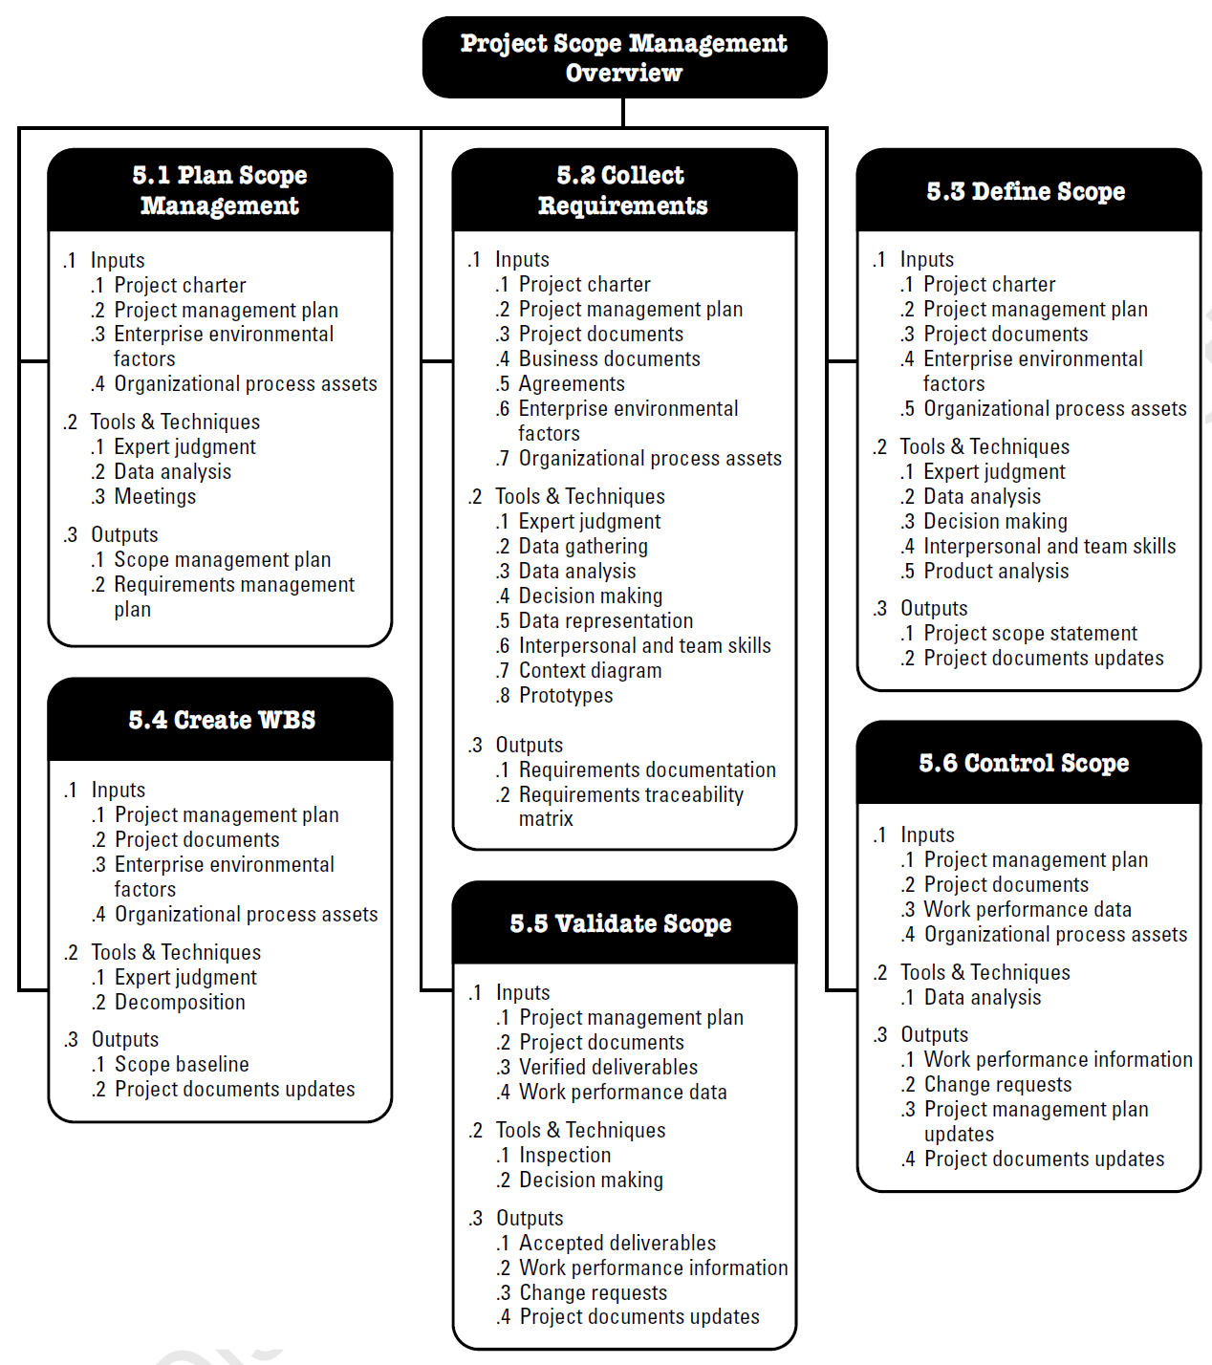
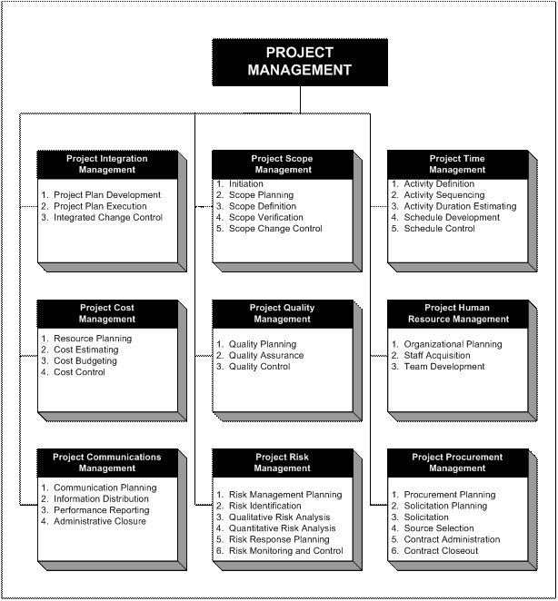
Project Management Framework
According to PMI, there are 09 knowledge areas for managing, i. Quality, ii. Cost, iii. Time, iv. Scope, v. Human resource, vi. Communication, vii. Risk, viii. Procurement and ix. Project integration.

Slide 17
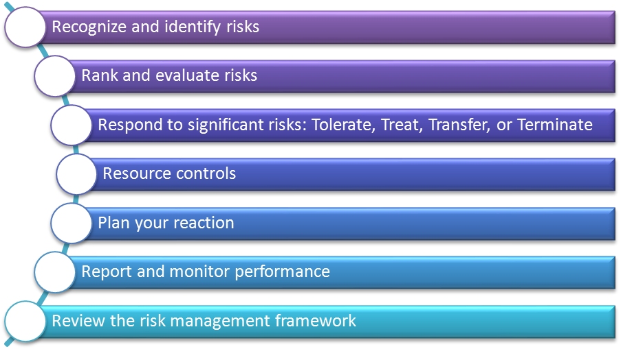
Risk Management
What is Risk?
The effect of uncertainty on objectives.
Typically related to one of four areas:
Strategy
Change management
Operations
Finance
Risks can be positive, negative, or neutral.
Quantitative risks are those that can clearly
be quantified.
Qualitative risks are those that cannot easily
be clearly quantified.

Slide 18
Change Management
Current State A Desired State A’
Transform - Reduce - Apply
WHY - WHAT - HOW
Unfreezing - Changing - Refreezing
Productivity during changes
Current State
Transition State
Future State
Employees (including management and executives!) generally prefer the current state, because that is where they live
The future state is unknown to the employee; will it be better, or worse? This is where Project teams “live”
The transition state creates stress and anxiety

Slide 19
How will you Communicate to change?
Building Commitment Through Communications is a process...
Communication
Internalization
Phase
Institutionalization
Adoption
Grudging
Formal
Genuine
Compliance
Compliance
Compliance
Installation
Commitment/
Installation
Installation
Compliance
Acceptance
Threshold
Phase
Positive Perception
Understand
Understand
the Change
the Change
Disposition
Preparation
Threshold
Phase
Awareness
Awareness
Awareness
I Contact
Noncommitment
Noncommitment
Noncommitment
Time
OC160

Slide 20
Resistance and Responses to Resistance
Resistance is inevitable, not bad
Change generates anxiety
Learning anxiety- not an expert, temporary incompetence, time & energy, may not master
Situational Anxiety- consequence if we don’t change
People generally work to conserve energy-or lower anxiety
Why will people choose to change- the situation
“because it matters”
“because my colleagues take it seriously””
“because it works”
Responses to Resistance
Dismissal: “You’re an idiot.”
Bulldozer: “You just don’t understand and I will try again to convince you of the correctness of my approach.”
Let’s talk: “What you say has merit. Let me understand your concerns and let’s review how an alternate proposal might address your concerns.”
Anticipate: Don’t be placed in a position of selling a proposal; instead position yourself as responding to a felt need.

Slide 21
Closing Summary
Project Management – Lead an endeavor
Planning is a map, a guide, especially for a team
Relatively simple and helpful techniques
Management is mostly about people
Goal, discipline, communicate
Risks are inevitable, planning helps to avoid stupid ones
Experience counts
Assessing the scope of work, timing, risks

Slide 22
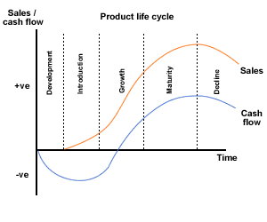
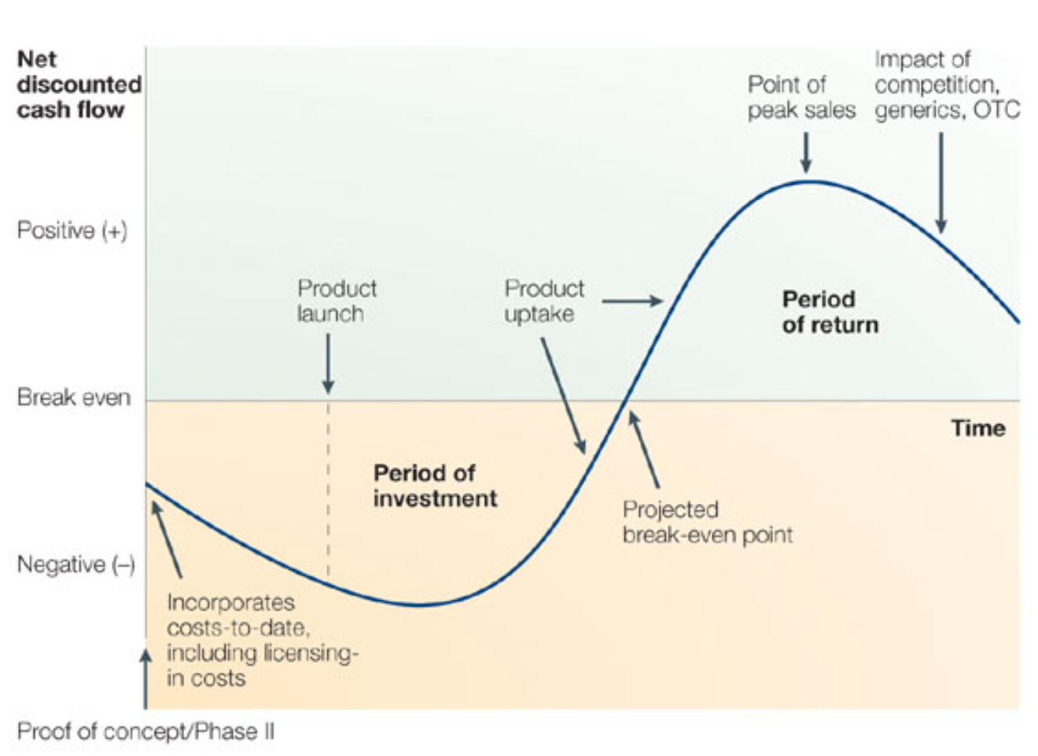
Financing the Journey & Time Value of Money
There is always a time lag between making the investment and generating revenue. For a period, cash will be flowing out—followed by cash flowing in. On the other hand, there is a cost of money due to interest and inflation. Hence, we need to take into consideration of cost of money in assessing economic feasibility of financing a journey in producing economic value from technology possibilities.
Types:
Debt financing
Equity financing

Slide 23
Basics of Time Value of Money
Money Has a Time Value. The concept of time value of money – a dollar received today, other things being the same, is worth more than a dollar received a year from now, underlies many financial decisions faced in business.
Construct cash flow timelines to organize your analysis of time value of money problems and learn three techniques for solving time value of money problems.
Understand compounding and calculate the future value of cash flow using mathematical formulas, a financial calculator, and an Excel worksheet.
Understand discounting and calculate the present value of cash flows using mathematical formulas, a financial calculator, and an excel spreadsheet.
Understand how interest rates are quoted and how to make them comparable.
A timeline identifies the timing and amount of a stream of cash flows along with the interest rate. A timeline is typically expressed in years, but it can also be expressed in months, days, or any other unit of time.

Slide 24
Interest Types—Simple and Compound
What is the difference between simple interest and compound interest?
Simple interest: Interest is earned only on the principal amount.
Compound interest: Interest is earned on both the principal and accumulated interest of prior periods.
Suppose that you deposit $500 in your savings account that earns 5% annual interest. How much will you have in your account after two years using (a) simple interest and (b) compound interest?
Simple Interest
Interest earned = 5% of $500 = .05×500 = $25 per year
Total interest earned = $25×2 = $50
Balance in your savings account:
= Principal + accumulated interest
= $500 + $50 = $550
Compound interest (assuming compounding once a year)
Interest earned in Year 1 = 5% of $500 = $25
Interest earned in Year 2 = 5% of ($500 + accumulated interest)
= 5% of ($500 + 25) = .05×525 = $26.25
Balance in your savings account:
= Principal + interest earned = $500 + $25 + $26.25 = $551.25

Slide 25
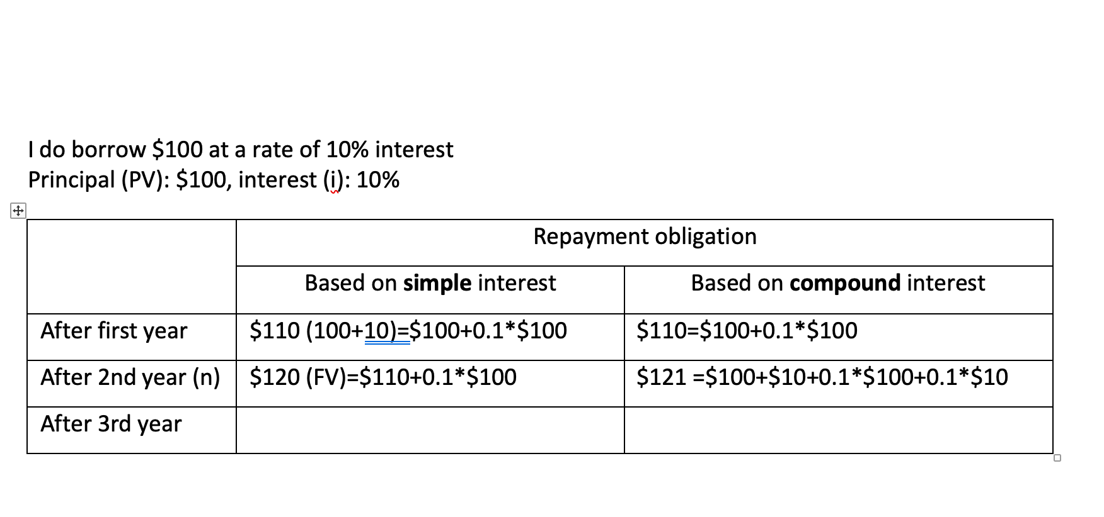

Slide 26
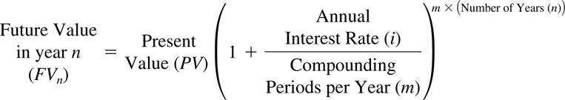
Present Value and Future Value
Future Value = Present Value x (1+Interest Rate per period)^{Number of periods}
For annual compounding (compounding once a year),
Future Value = Present Value x (1+Annual Interest Rate)^{Number of years}
If nothing is said, assume annual compounding.
FV_{n}= PV(1+i)^{n}
Another way to write the future value equation, in terms of annual rates and years:
What is value today of cash flow to be received in the future?
The answer to this question requires computing the present value, i.e., the value today of a future cash flow, and the process of discounting, determining the present value of an expected future cash flow.
We can get PV from FV: PV=FV_{n}/(1+i)^{n}
Compound (multiply) to get future value; discount (divide) to get present value. Discounting is a useful technique to estimate equivalent present value of likely future income from the project or product investment.

Slide 27
Answering Some Time Value Questions
Key Question: How long will it take to accumulate a specific amount in the future?
FV=PV(1+i)^{n}
(FV/PV)=(1+i)^{n} ← Move PV to the left.
ln(FV/PV)=n ln(1+i) ← Take natural logs (ln) on both sides
n=[ln(FV/PV)]/[ln(1+i)] ← Move ln(1+i) to the left, switch sides.
Rule of 72: Rule of 72 is an approximate formula to determine the number of years it will take to double the value of your investment.
Rule of 72: N = 72/interest rate in percentage
Key Question: What rate of interest will allow your investment to grow to a desired future value?
FV=PV(1+i)^{n}
(FV/PV)=(1+i)^{n} ← Move PV to the left
(FV/PV)^{(1/n)}=1+i ← Take (1/n) root on both sides
i=(FV/P)^{(1/n)}-1. ← Move 1 to the left, switch sides.

Slide 28
Present Value and Future Value
Time value of money calculations involve Present value (what a cash flow would be worth to you today) and Future value (what a cash flow will be worth in the future).
In example 1, Present value is $500 and Future value is $551.25 (if the yearly compounding rate is 5%).
The linkage between present value and future value is:
Future Value = Present Value x (1+Interest Rate per period)^{Number of periods}
For annual compounding (compounding once a year),
Future Value = Present Value x (1+Annual Interest Rate)^{Number of years}
If nothing is said, assume annual compounding.

Slide 29
Discounting and Present Value
What is value today of cash flow to be received in the future?
The answer to this question requires computing the present value, i.e., the value today of a future cash flow, and the process of discounting, determining the present value of an expected future cash flow.
Since we know how to compound to get future value:
FV_{n}=PV(1+i)^{n}
We can get PV from FV:
PV=FV_{n}/(1+i)^{n}
Compound (multiply) to get future value; discount (divide) to get present value.
Present value is smaller than future value with positive rate.

Slide 30
Making Interest Rates Comparable
The annual percentage rate (APR) indicates the amount of interest paid or earned in one year without compounding. APR is also known as the nominal or stated interest rate. This is the rate required by law.
We cannot compare two loans based on APR if they do not have the same compounding period.
To make them comparable, we calculate their equivalent rate using an annual compounding period. We do this by calculating the effective annual rate (EAR).
APR is the quoted annual rate with a pre-specified compounding frequency. [Let m be the number of compounding periods per year for this APR.]
EAR is the effective annual rate at an annual compounding frequency. [One compounding per year]
The two should generate the same amount of money in one year:
(1+APR/m)^{m}=(1+EAR) → EAR=(1+APR/m)^{m}-1.

Slide 31
Continuous Compounding
When the time intervals between when interest is paid are infinitely small, we call it continuous compounding. In this case, future value and present value is linked as:
FV=PV e^{r t}
r is the continuous compounding rate, t is number of years.
E is the “natural number” 2.71828
Continuous compounding rate is linked to EAR as
EAR= e^{r} - 1, again obtained by matching the one-year future value from the two compounding frequencies.

Slide 32
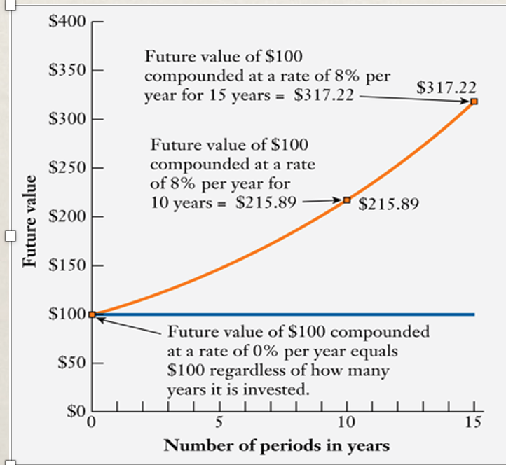
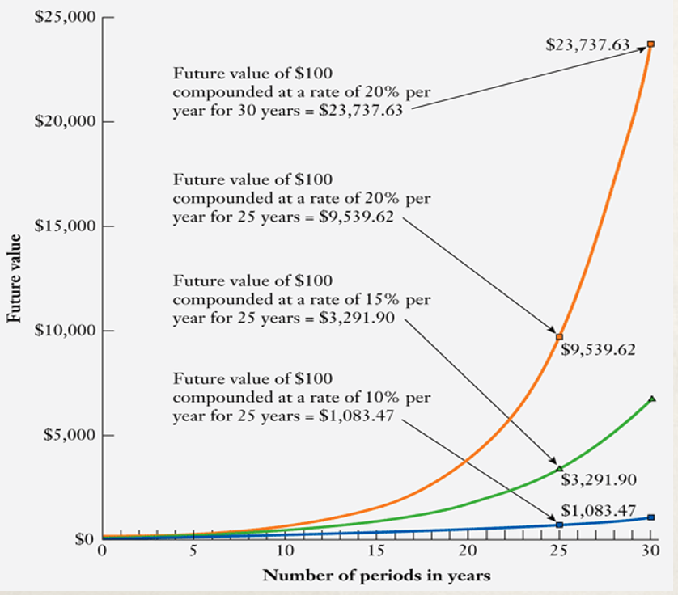
Beware of Power of Time and Compounding
Future value of original investment increases with time, unless interest rate is zero.
But does it increase linearly? No, if interest is calculated using compounding. In fact, both time period and interest rate have exponential nature of impact on repayment obligation. It means that repayment obligation keeps exponentially growing with time period and interest rate.
The long term effect of exponential nature of growth of repayment obligation significantly influences economic feasibility of an idea or project. Many engineering projects like power plants or cloud platforms have repayment period extended to 25 years. 50% variation in interest rate increases repayment obligation by 300%, and if interest rate doubles, repayment amount increases by 1000%.
Hence, in assessing economic feasibility of an idea or project, effect of interest rate should be seriously taken into consideration, and alternate sources finance should be well investigated.

Slide 33
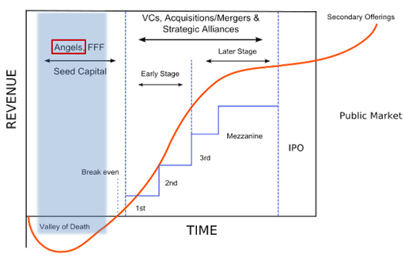
Startup Financing
Once entrepreneurs run out of their initial fund provided by themselves, families and friends, often, they approach angel financing. Angel investors are typically individuals who invest in startup or early-stage companies in exchange for an equity ownership interest.
Next round of financing, usually, approaches venture capital (VC) funds. In exchange of equity, these VC funds provide capital; strategic assistance; introductions to potential customers, partners, and employees; and much more.
Venture capital financings are not easy to obtain. Venture capitalists typically want to invest in startups that are pursuing big opportunities with high growth potential, and that have already shown some traction; for example, they have a working product prototype, early customer adoption, etc.
Venture capitalists typically focus their investment efforts using one or more of the following criteria: (i) Specific industry sectors (software, digital media, semiconductor, mobile devices, etc.) (ii) Stage of company (early-stage seed or Series A rounds, or later stage rounds with companies that have achieved meaningful revenues and traction), and (iii) Geography.
The Five Stages of Startup Financing
Stage 1: Seed capital. ...
Stage 2: Startup capital. ...
Stage 3: Early stage/first stage/second stage capital. ...
Stage 4: Expansion stage/second stage/third stage capital…
Stage 5: Mezzanine/bridge/pre-public stage.
Venture Funding Rounds
Seed Funding
Series A
Series B
Series C

Slide 34
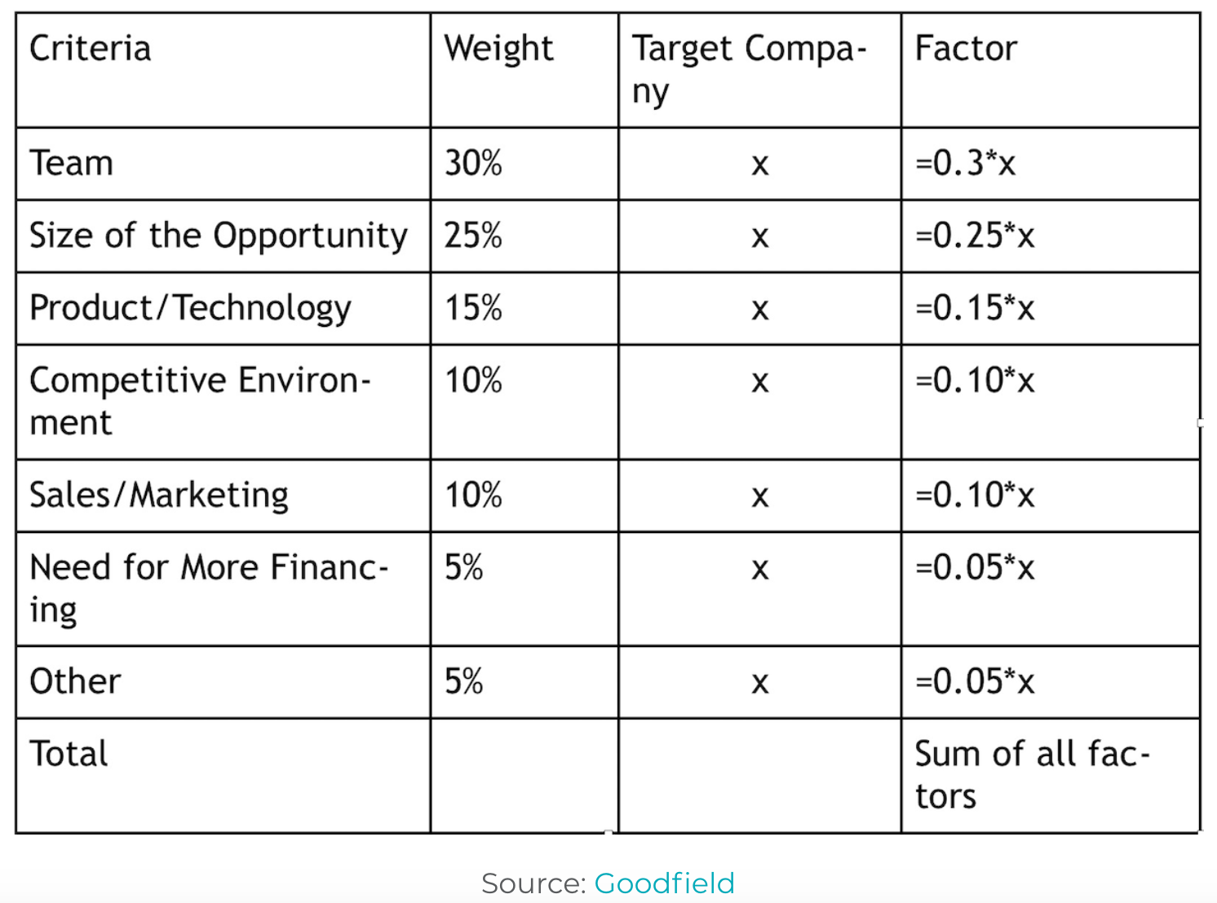
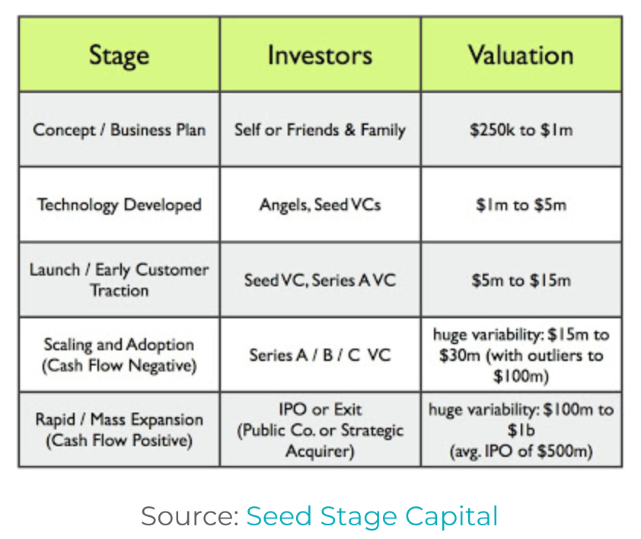
Startup valuation—linked with financing
Method 1: Berkus Method
This method assesses five critical aspects of a startup:
Concept – The product offers basic value with acceptable risk.
Prototype – This reduces technology risk.
Quality management – If it’s not already there, the startup has plans to install a quality management team.
Connections – There are some strategic relationships in place already, which reduces competitive risks in the market.
Launch plan – There is some evidence of a sales plan and preparation for product rollout. (This doesn’t apply to all pre-revenue startups)
Method 2: Scorecard Valuation Method
Method 3: Cost-to-Duplicate

